Slide 1

TEAM 11

Slide 2

AGENDA
Exploratory Data Analysis
Feature Engineering
Anomaly Detection
Time Series Models
Stacked Predictions
Notes:
Good Afternoon Judges, To keep you align with the agenda of this presentation We will first start with a big picture of what we are going to present during the course of our presentation,. We will start with our understanding of the problem statement provided, along with some traditional exploratory data analysis. Then we will explain how we have developed intelligent features and removed outliers to help our models learn better. We then move on to explain different models we have applied and the results which we have got on the validation set. Finally we found that there is no one model to rule them all, and hence stacking the predictions from different models is the solution. So let us begin.

Slide 3


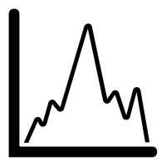



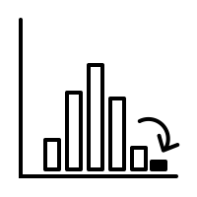
Understanding the Data & Problem Statement
5 Corporate Buildings under Dream Vidyut’s Supervision.
1 Main-meter, 2 Sub-meters for each.
Meter readings for 15 minutes each for 15 Time series.
Developing Intelligent & Data-driven forecasting model for electricity consumption
DATA SUMMARY
INSIGHTS
 | Main meter | Submeter 1 | Submeter 2
Mean | 6095.76 | 2092.88 | 776.83
Std | 3485.12 | 1135.88 | 883.49
Min | 61.63 | 0.00 | 0.00
25% | 3455.91 | 1365.00 | 4.85
50% | 5362.18 | 2075.67 | 621.91
75% | 7685.40 | 2772.50 | 1365.89
Max | 23174.60 | 17206.16 | 4392.07
Meter Consumption Levels
It is also clear that main meter has higher consumption when compared to that of sub meter 1 and submeter 2.
Existence of Outliers
From the mean, 75% and the maximum readings
of the meters, it can be seen that the dataset consists of outliers that have to be treated for better prediction.
Notes:
Dream Vidyut is a electricity generation company which aims to accurately forecast electricity consumption to avoid the problems caused due to demand supply mismatch.
We are given with the electricity consumption data of 5 corporate buildings, through it’s meter readings at the interval of 15 minutes each from April to December. And our task is to develop intelligent & data-driven models to provide with efficient electricity consumption forecasting.
Here, is the glimpse of the data summary, for meter readings aggregated over the buildings. We can clearly see that Meter consumption levels for main meter is significantly higher than that of submeter 1 & submeter 2. Also, we can see there is high difference between the maximum values and the median values, which clearly shows that there exists outliers which give us a hint for the existence of outliers treating which could help us build more generalized and robust models.

Slide 4
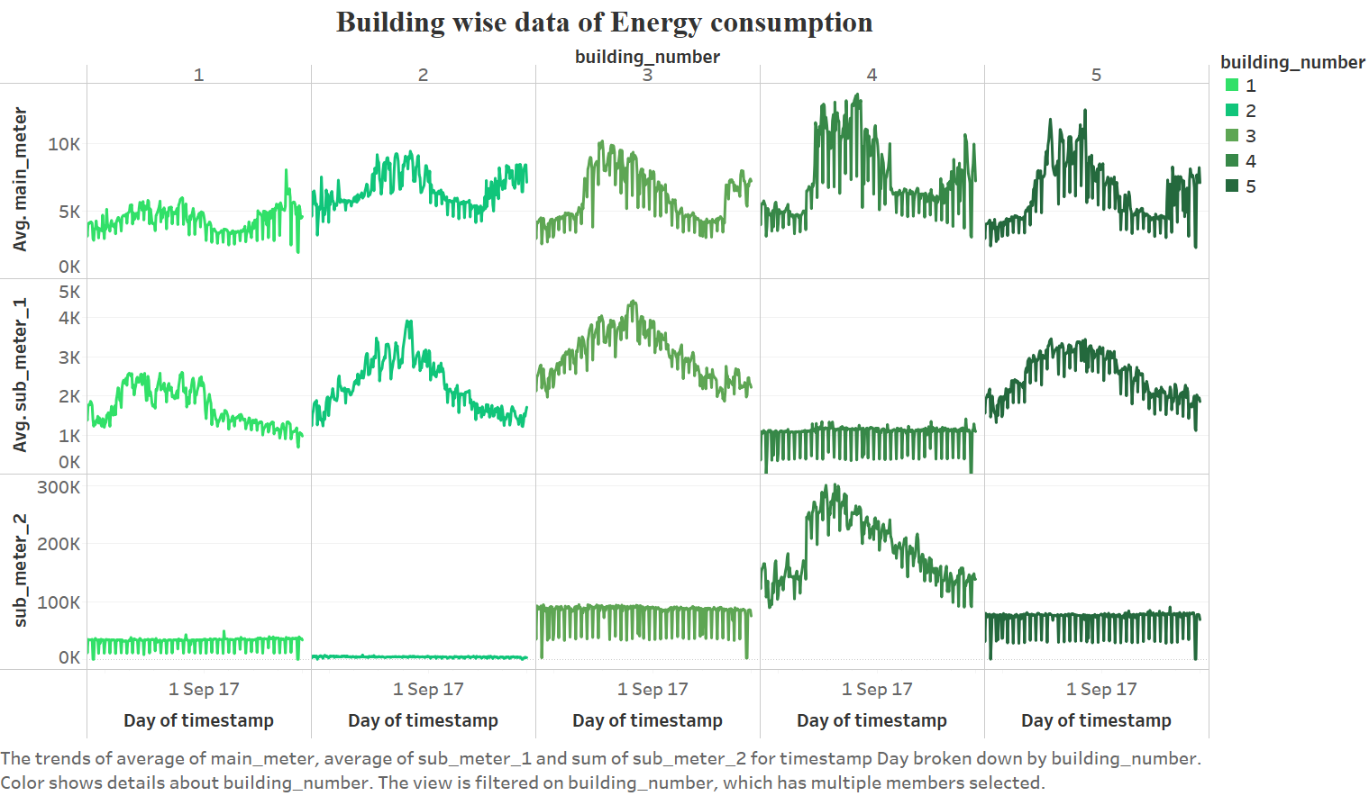
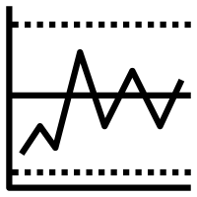

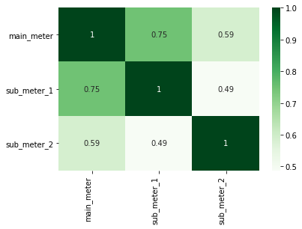
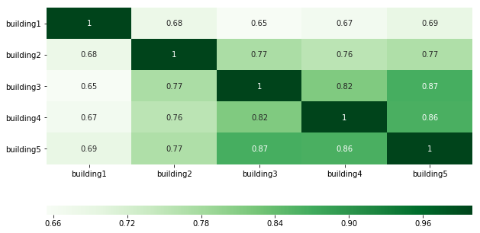
Data Visualization and Insights
BUILDING-WISE ENERGY CONSUMPTION DATA
OUR INSIGHTS
It is noticeable that the variance of readings of the main meter are considerably higher than that of the sub-meters.
The trends of main_meter, submeter 1 & submeter 2 broken down by building numbers.
CORRELATION MATRICES
Fair correlations are visible within the energy consumption of different corporate buildings, as well as meters.
METER-WISE
BUILDING-WISE
Notes:
Let us see how these time series varies. Here is a canvas of all the 15 time series for different combinations of buildings and meters.
It is visible that the variation in Main meter is much higher as compared to sub meter 1. While submeter 2 remains nearly at the same level with a exception in the case of Building 4.
We have also visualized the correlation matrices for the consumption levels meter-wise as well as building-wise. We can see that there is a fair correlation between consumption level for different meters. Main meter and submeter 1 are fairly correlated with a correlation of 0.75. Also, buildings show good correlation levels which can be intuitively supported by the idea that all of them are corporate buildings.

Slide 5
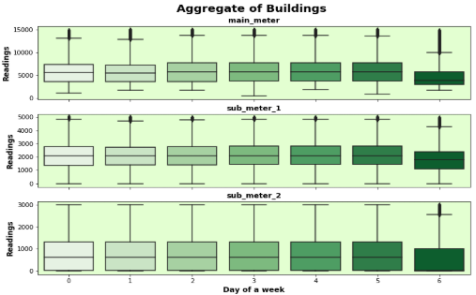
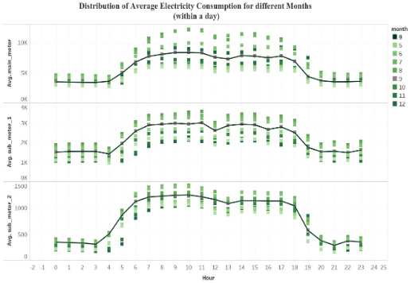
Intuition behind Feature Engineering
Seasonality within a week
Seasonality within a day
Clear difference in the electricity consumption at the weekend and non-weekend days.
Difference of Consumption levels during corporate hours and non-corporate hours.
Is Weekend?
Is Corporate?
‘Weekend’ has value of 1 on sundays and a value of 0 on weekdays.
‘Corporate’ has a value of 1 on corporate hours (8AM to 8PM) and a value of 0 on non corporate hours.
Notes:
Feature engineering is one the important steps in data analytics, This is where actual creativity comes in. We have observed that our electricity consumption have two kind of seasonality. Seasonality within a week,

Slide 6
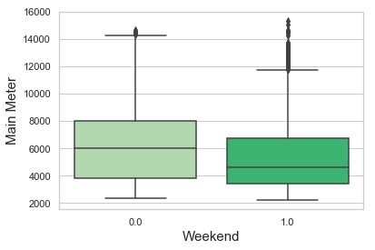
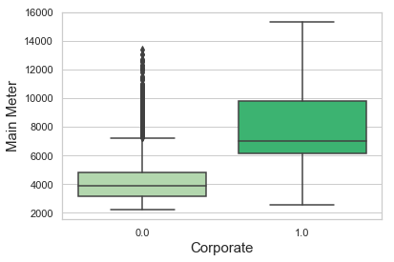
Statistical T-Test to confirm Difference in Consumption Levels
T-Tests were conducted to statistically prove that there is a significant difference between the electricity consumption for different levels of the created features. (95% confidence interval is used)
T-Test Results for ‘Weekend’
T-Test Results for ‘Corporate’
Meter | Mean Difference | Standard Error | |T-Statistic| (|t|) | Critical Value (α) | P-Value
Main Meter | 1603.547 | 43.673 | 36.718 | 1.645 | 0.000
Sub Meter 1 | 408.776 | 16.672 | 24.519 | 1.645 | 0.000
Sub Meter 2 | 304.267 | 12.369 | 24.600 | 1.645 | 0.000
Meter | Mean Difference | Standard Error | |T-Statistic| (|t|) | Critical Value (α) | P-Value
Main Meter | 3468.002 | 27.564 | 106.073 | 1.645 | 0.00
Sub Meter 1 | 935.615 | 10.888 | 84.227 | 1.645 | 0.00
Sub Meter 2 | 605.682 | 9.017 | 67.174 | 1.645 | 0.00
BOX PLOT FOR
MAIN METER READINGS
Notes:
Degree of Freedoms - 32998 Confidence Level = .95

Slide 7
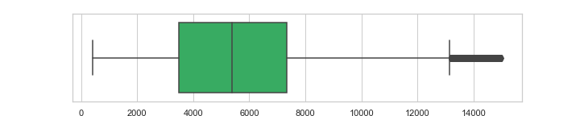
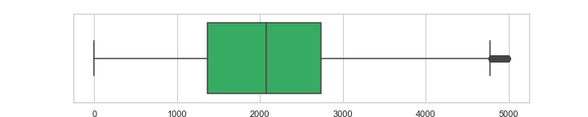
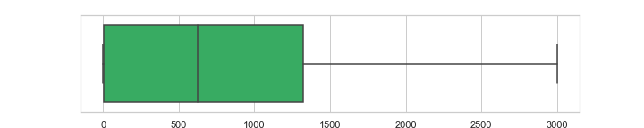
Detecting & Replacing Anomalies for Robust Predictions
Main Meter
2.65%
Sub Meter 1
0.45%
Sub Meter 2
2.13%
Since the anomalies constitute a very insignificant percentage of the series, treating these should not affect the series adversely. The anomalies are replaced by the respective median values.
Notes:
Anomaly detection and if present its treatment is an important part of any real world data problem. By plotting the box plots over the building data, it is very evident that there are outliers,treatment of which should improve the accuracy. The outliers are replaced by median of the respected series. Since the anomalies constitute of very small percentage of the series, treating them should not significantly affect the series.

Slide 8
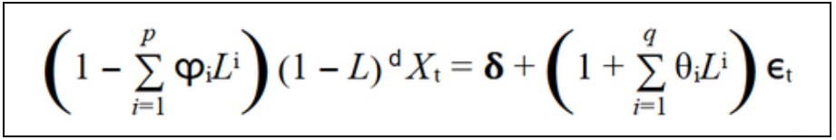
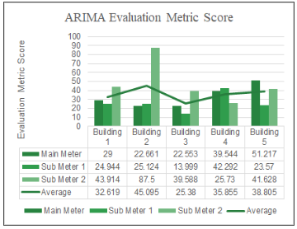


ARIMA (Autoregressive Integrated Moving Average)
ARIMA model is a class of statistical models for analyzing and forecasting time series data.
It forecasts values for equally spaced univariate time series data in a response time series as a linear combination of its own past and present values and past errors.
WHY ARIMA?
RESULTS:
Base Model
Captures Mean
Notes:
The AR(AutoRegressive) part of ARIMA indicates that the evolving variable of interest is regressed on its own lagged (i.e., prior) values. The MA(Moving Average) part indicates that the regression error is actually a linear combination of error terms whose values occurred contemporaneously and at various times in the past. The I (for "integrated") indicates that the data values have been replaced with the difference between their values and the previous values (and this differencing process may have been performed more than once). The purpose of each of these features is to make the model fit to the data as well as possible.
The very obvious question is why we have preferred arima over other models.
ARIMA is one of the most common statistical models tailor-made for forecasting univariate time series data. It captures the mean or the linearity pattern of the data well. This is particularly useful in case of the sub-meter 2 readings, which have very little variance and are spread over a comparatively short range of values, thus giving us desirable results.

Slide 9


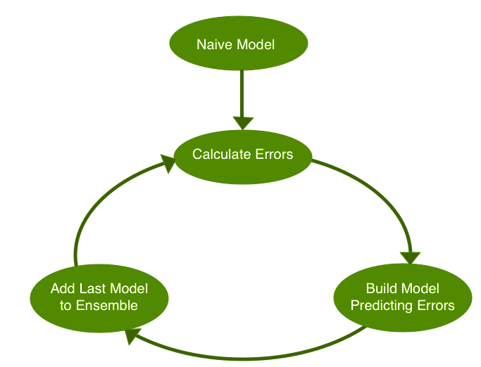
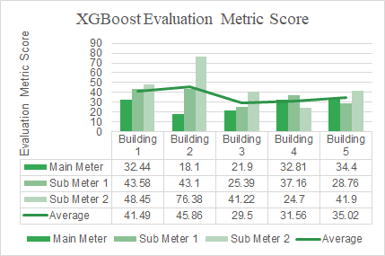
XGBoost (eXtreme Gradient Boosting)
XGBoost is an optimized distributed gradient boosting library designed to be highly efficient, flexible and portable.
It implements machine learning algorithms under the Gradient Boosting framework.
WHY XGBOOST?
Model Performance
Execution Speed
RESULTS
Notes:
Theory
XGBoost is an optimized distributed gradient boosting library designed to be highly efficient, flexible and portable. It implements machine learning algorithms under the Gradient Boosting framework. It is an approach where new models are created that predict the residuals or errors of prior models and then added together to make the final prediction. It is called gradient boosting because it uses a gradient descent algorithm to minimize the loss when adding new models.
Why XGBoost?
The two reasons to use XGBoost are also the two goals of the project:
Execution Speed: It is really fast when compared to other implementations of gradient boosting.
Model Performance: It dominates structured or tabular datasets on classification and regression predictive modelling problems.
Finally, the evidence is that it is the go-to algorithm for competition winners on the Kaggle competitive data science platform.
After time series model, we implemented ML models to check if it could possibly improve the results. XG Boost was chosen mainly because of its higher execution speed.
It calculates errors and residuals of a base model and uses them to keep building better models, until it can reduce the loss as much as possible.
However, the results obtained were worse compared to ARIMA, which is perhaps because XGB didn’t take the time series pattern of the data into consideration.

Slide 10
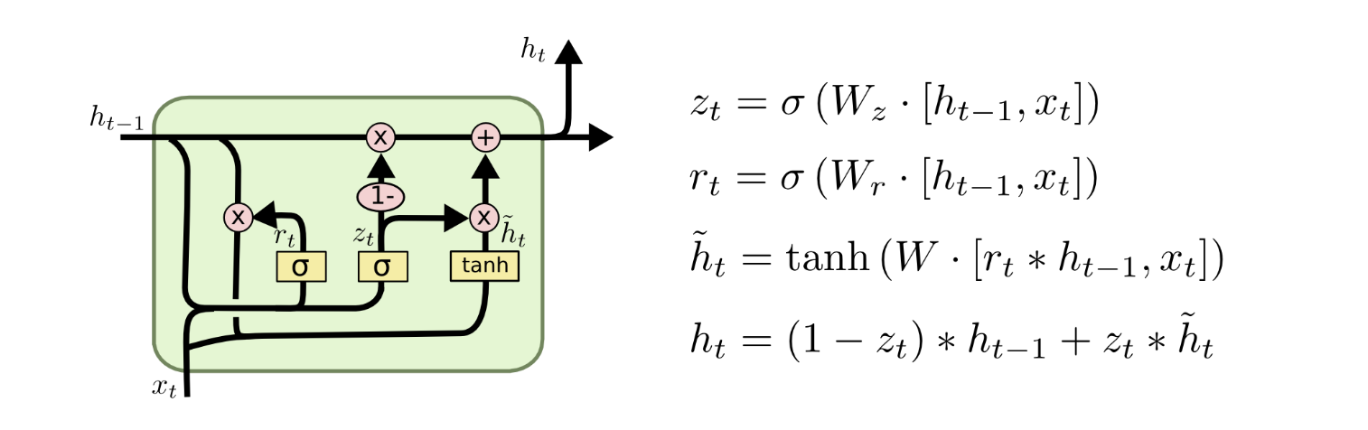
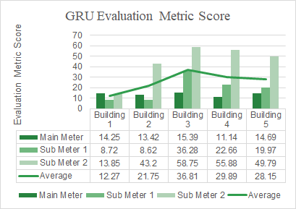


GRUs (Gated Recurrent Units)
GRUs are improved version of standard recurrent neural network.
GRU uses, so-called, update gate and reset gate which are two vectors which decide what information should be passed to the output.
WHY GRU?
RESULTS
Computationally Efficient than other deep learning based models.
Features and past values can be simultaneously feeded.
Notes:
It is well known that Deep Learning Models usually outperform traditional Machine Learning Methods and other statistical based models, so we tried multiple deep learning based methods in our case and by the results, we observed that GRUs among all other desp learning based models performed the best. As we know that GRU is an improvised version of standard RNNs, it is able to capture long term trends and it effectively deals with the vanishing gradient problem. In addition to this, GRUs are computationally efficient as compared to its well known counterpart, LSTMs. It is expected to get better results, as compared to previous models like arima, we are able to integrate both hand crafted features and past values and as expected we get marginally better results for main meter and sub_meter1. However for submeter2, the results of arima is better then GRU. For further slides, please note that main_meter and sub_meter1 have higher variance as compared to sub_meter2.

Slide 11
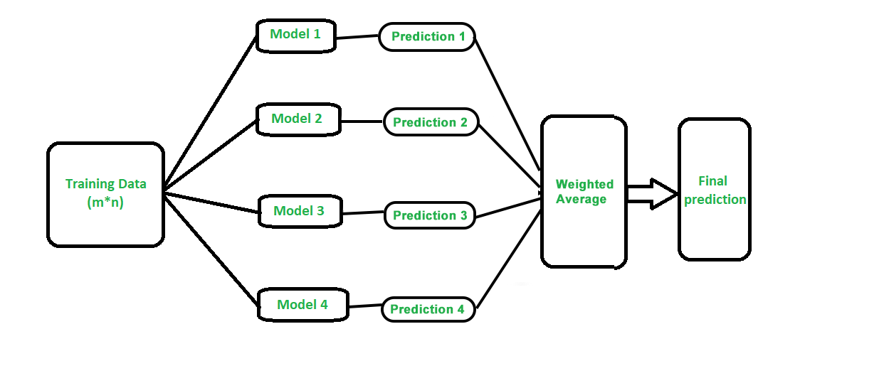
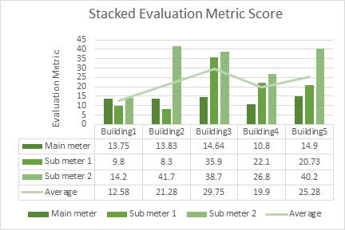
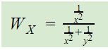
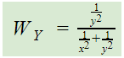
Stacked Predictions
Stacked predictions allow you to make “out-of-sample” predictions and prevent misleadingly high accuracy scores.
Stacked
Predictions
(Weighted
Average)
Weights
Final Results on Validation Test
Stacking the predictions from :
X: GRU & Y: ARIMA
Using Weights
W_{X} → Weight of model X
W_{Y} → Weight of model Y
x → Evaluation metric score of model X.
y → Evaluation metric score of model Y.
Notes:
Stacked prediction is usually used to integrate prediction from multiple models to get results which is more robust. In our case, We observe that no one models performs the best on all the meters. This is because the properties of the series are different. So we decided to stack the predictions from GRU and Arima because GRU captures the variance well and Arima is mean-centric. To determine the weigths we decided to use the given formula based where x and y are the result of these model on validation set. We can see that if results are better then that model gets more weight. These are the final results from stacked prediction.

Slide 12
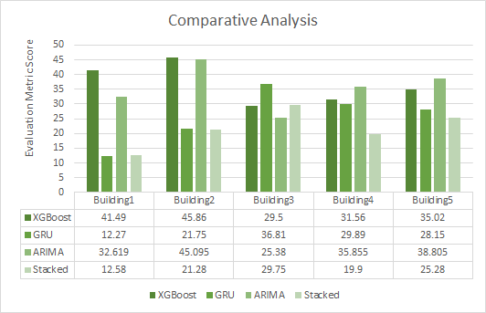
Stacked Predictions v/s Other Models
Notes:
This is the comparative analysis of all the models and approaches which we have used and we observe that the stacked approach performs the best on the aggregate level on the validation set.

Slide 13




Summary
Feature Engineering
Model Building
Individually Inferior
Stacked Predictions
01
02
03
04
Incorporating new features like corporate hours and weekend helped increase accuracy
Applied models of different classes such as Statistical, Machine learning and Deep learning.
No individual model performed well on all buildings across meters.
Stacked results from ARIMA and GRU, gave the best results.
After stacking GRU and ARIMA models, we are having a 15% better evaluation score as compared to GRU and a 39% better evaluation metric score as compared to ARIMA.
Notes:
Concluding the presentation, we see that stacked prediction is x% better than Arima, y% better than XGBoost and z% better than GRU on an aggregate level.

Slide 14
THANK YOU

Slide 15
Backup Slides
1
STATISTICAL T-TEST FOR DIFFERENT METER READINGS
2
WHY 1 HOUR AGGREGATE IS CHOSEN
3
GRU ARCHITECTURE
4
LSTM VS GRU
5
WHY NOT XGBOOST?
6
WHY ARIMA?
7
CORRELATION MATRICES
8 BOX PLOTS
9 WHY MEDIAN OVER MEAN
10 EVALUATION METRIC
11 BUILDING WISE COMPARISONS BETWEEN DIFFERENT MODELS

Slide 16
Statistical T-test For Different Meter Readings
A t-test is a type of inferential statistic used to determine if there is a significant difference between the means of two groups, which may be related in certain features. This test is done where the variance is unknown like in real world datasets, due to which it is preferred over z- test in the given dataset.
(Paired T-Test)
H₀: μ_{actual} = μ_{forecast}
H_{a}: μ_{actual} ≠ μ_{foreast}
(T - Statistic Value)
t₀=( X_{actual} - X_{forecast})/( S_{e} )
where,
X_{actual} : sample mean of actual values.
X_{forecast}: sample mean of forecasted values.
t_{α,n-1} : t_{critical} at α level of significance and n-1 degrees of freedom.
S_{e} : standard error ( standard deviation / √n )
n : sample size
t₀ : t-statistic
MAIN METER SUB-METER 1 SUB-METER 2
Table: Values used in T-Test | Weekend | Corporate
X_{actual} - X_{forecast} | 1603.547 | 3468.002
S_{e} | 43.673 | 27.564
t₀ | 36.718 | 106.073
t_{α,n-1} | 1.645 | 1.645
Result | ∵ t₀>t_{α,n-1} ⇒Null hypothesis is rejected.
Table: Values used in T-Test | Weekend | Corporate
X_{actual} - X_{forecast} | 408.776 | 935.615
S_{e} | 16.672 | 10.888
t₀ | 24.519 | 84.227
t_{α,n-1} | 1.645 | 1.645
Result | ∵ t₀>t_{α,n-1} ⇒Null hypothesis is rejected.
Table: Values used in T-Test | Weekend | Corporate
X_{actual} - X_{forecast} | 304.267 | 605.682
S_{e} | 12.369 | 6727
t₀ | 24.600 | 67.174
t_{α,n-1} | 1.645 | 1.645
Result | ∵ t₀>t_{α,n-1} ⇒Null hypothesis is rejected.

Slide 17


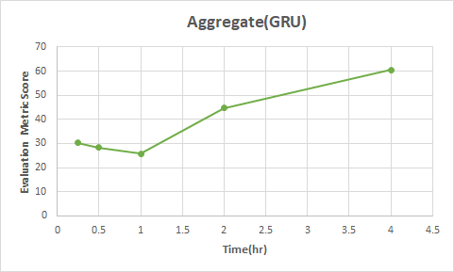
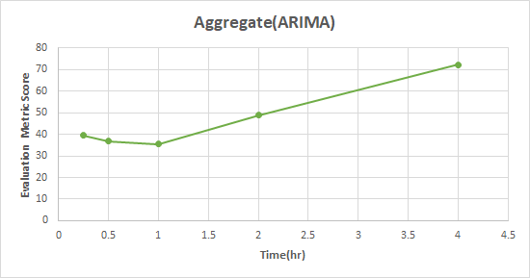

Why an aggregate of 1 hour is chosen over other aggregates?
We observed that prediction made at an aggregate level of 1 hour provided the best results across different models.

Slide 18
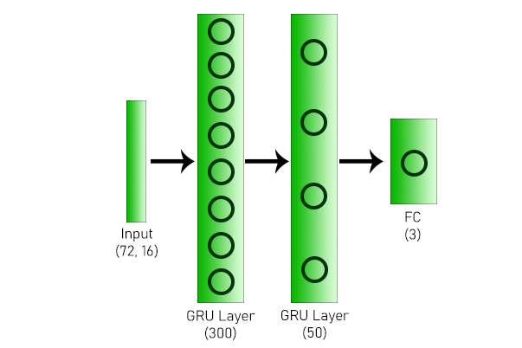
GRU Architecture

Slide 19
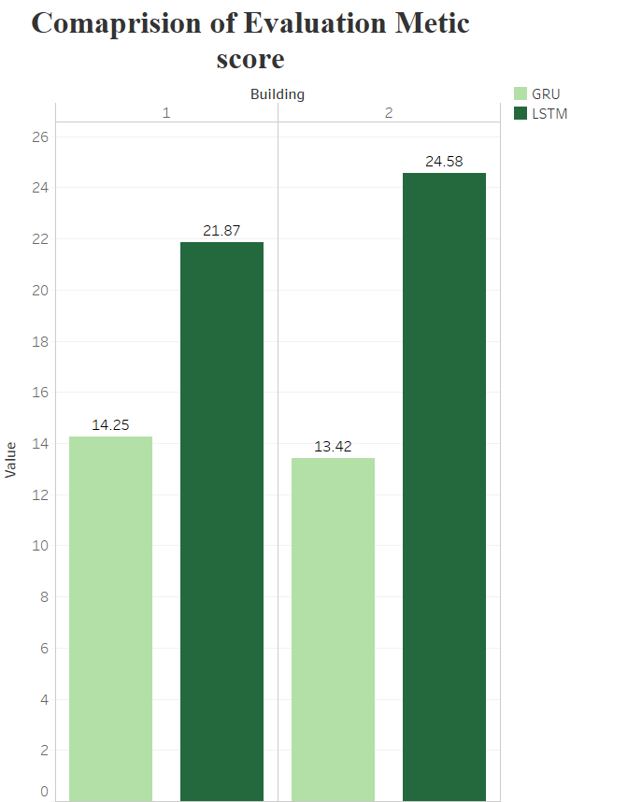
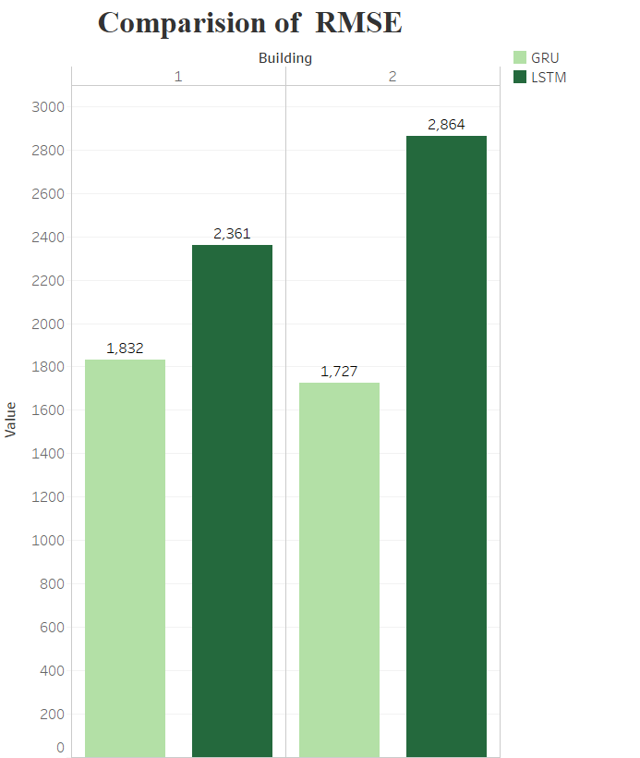

LSTM vs GRU: Model Comparison based on RMSE and Evaluation Metric Score
GRU controls the flow of information without having to use a hidden memory unit
GRU is computationally more efficient and produce much better results as compared to LSTM thus outperforming it empirically

Slide 20
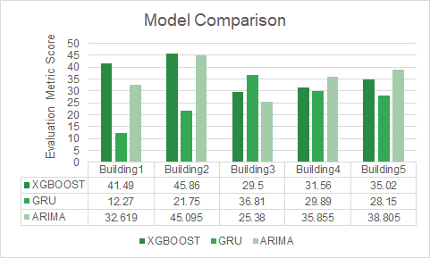
Why not XGBoost?
Experimental Results
Theoretical Explanation
XGBoost is a Machine learning model while GRU and ARIMA captures sequential data better than XGBoost.
Given dataset has components of both variance and linearity which are captured best by GRU and ARIMA respectively
GRU and ARIMA are specifically built for dealing with Time Series data.
This can be seen from above graph that our theoretical intuition is coinciding with the experimental results. Evaluation metric score of XGBoost is not best for any the buildings in comparison to ARIMA and GRU.
Notes:
XGboost is a ml model while time series models like Arima and neural networks like GRU capture sequential data properly. Given data has components of both variance and linearity. GRU capture components of variance while linearity is best captured by ARIMA. GRU and ARIMA are specifically built for dealing with Time series data

Slide 21


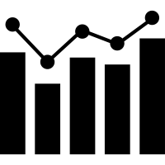
Why ARIMA?
AUTO REGRESSIVE(AR)
A model that uses the
dependent relationship between an observation and some number of lagged observations.
MOVING AVERAGE(MA)
A model that uses the dependency between an observation and a residual error from a moving average model applied to lagged observations.
INTEGRATED(I)
The use of differencing of raw observations in order to make the time series stationary.
Notes:
ARIMA methodology also allows models to be built that incorporate both autoregressive and moving average parameters together. These models are often referred to as "mixed models". Although this makes for a more complicated forecasting tool, the structure may indeed simulate the series better and produce a more accurate forecast. Pure models imply that the structure consists only of AR or MA parameters - not both.The models developed by this approach are usually called ARIMA models because they use a combination of autoregressive (AR), integration (I) and moving average (MA) operations.
using auto arima , we are getting better results by ignoring the seasonality parameters.

Slide 22
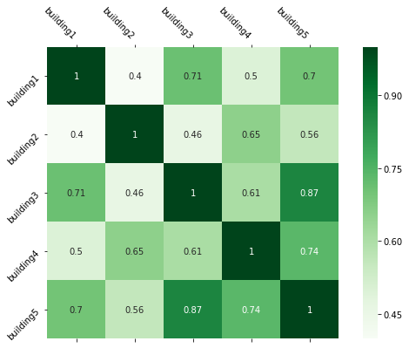
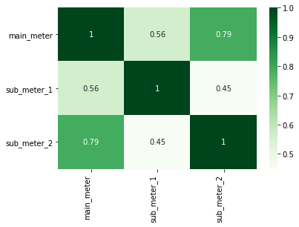
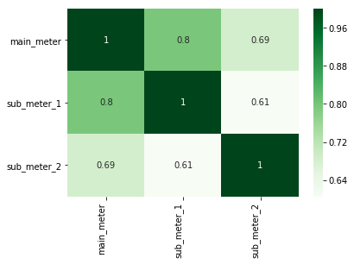
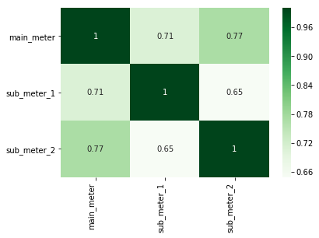
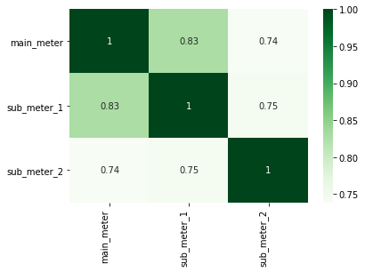
Correlation Matrices
Sub Meter 1
Sub Meter 2
Main Meter
Building 1
Building 2
Building 3
Building 4
Building 5

Slide 23
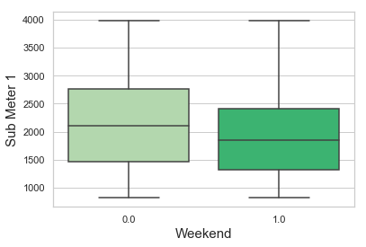
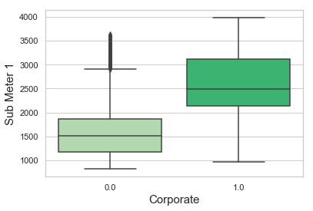
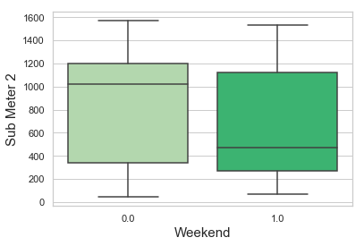
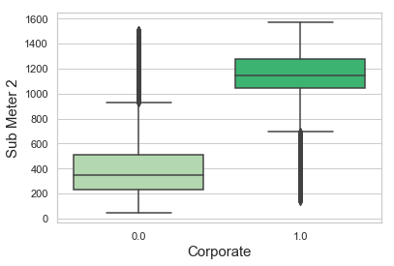
Box Plot For Sub Meter 1 and 2 Readings
SUB METER 1
SUB METER 2

Slide 24
Why Median Why not Mean?
Usually imputing with mean or median is a important question. It always depends on the distribution of the data, which to use. In the data given the outliers value are far away from the 75%le hence imputing with median is the good option.

Slide 25
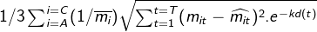


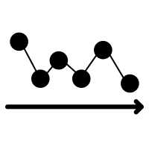
Evaluation Metric
A, B and C represent Main meter, Sub-meter 1 and Sub-meter 2 respectively
T is the total number of timestamps in the test.csv for a particular building,
t is the timestamp for which prediction is being made,
k = (ln 2) / 100
m(it) is the actual value of meter i at time step t
Caret(m(it)) is the predicted value of meter i at time step t
Bar(m(i)) is the mean value of meter i - This value is used for normalization
Metric Score depends on the number of observations it is calculated for, as it is not normalized over T.
e-kd(t), is basically added to down weight predictions farther in future,therefore decreasing the error value with days of the month.
Evaluation Metric Error also depends on inherent data scale and its variance .

Slide 26
BUILDING WISE COMPARISONS BETWEEN DIFFERENT MODELS
AS COMPARED TO STACKED MODEL
MODEL | Building 1 | Building 2 | Building 3 | Building 4 | Building 5 | Aggregate
XGBOOST | 41.49 | 45.86 | 29.50 | 31.56 | 35.02 | 36.68
GRU | 12.27 | 21.75 | 36.81 | 29.89 | 28.15 | 25.77
ARIMA | 32.61 | 45.09 | 25.38 | 35.85 | 38.80 | 35.55
Stacked | 12.58 | 21.28 | 29.75 | 19.9 | 25.28 | 21.758
Improvement from GRU | -2.52% | 2.16% | 19.17% | 33.42% | 10.19% | 15.58%
Improvement from ARIMA | 61.43% | 52.81% | -17.21% | 44.49% | 34.85% | 38.79%
Cell(i,j) where 2≤i≤7, 2≤j≤5 represents evaluation metric score
Cell(i,j) where 2≤i≤7, 6≤j≤7 represents % improvement in evaluation metric score after stacking

